Slide 1
Inscopix analysis
Knight Lab
Nov 2021
James Grove

Slide 2
Preprocessing data
Transfer data off the DAQ using an NTFS formatted hard drive
Open new_inscopix_preprocess.m in Matlab
Make sure the computer has the most recent inscopix IDAS software installed
Insert the list of video filenames into the script where indicated
Decide the amount you want the video to be downsampled by
Temporal downsampling by X will average every X frames
Ie. Downsampling a 20fps video by 5 will result in a 4fps video
Spatial downsampling by X will average every X pixels in each dimension
Ie. Downsampling a 40x40 video by 4 will result in a 10x10 video

Slide 3
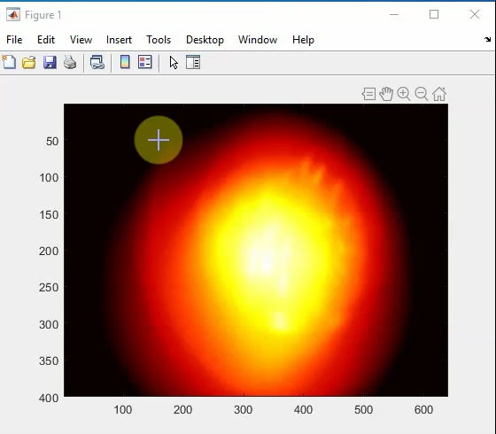
Preprocessing data
Run the script
Eventually, a window will pop up for you to crop your video
This should happen after about 5 min X (number of videos)
Click and drag to crop. Double click the crop box when done.

Slide 4
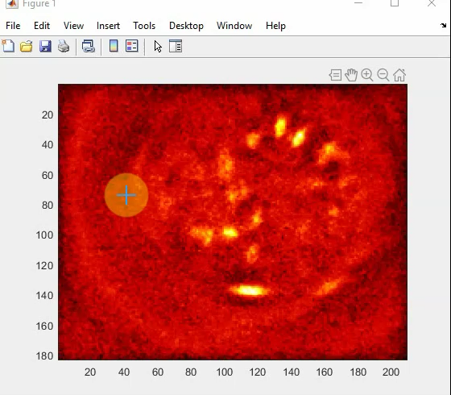
Preprocessing data
The script will downsample and crop first
Then it will put the video through a spatial bandpass
Then it will correct for motion
Before starting motion-correction, another window will pop up
Click to set a polygon around the lens boundaries and double click it when done

Slide 5
Preprocessing data
After motion correction, the script will export the video in .tiff format
This video will be named (original video name)-pp-BP-MC.tiff
Double check the video for any remaining motion artefacts
Put the new video through the script again if motion is still noticeable
Sometimes motion is not uniform and it might make sense to split up the video into quadrants/etc
If the motion cannot be corrected, do another recording

Slide 6
Running CNMFe
Open batch_for_cnmfe in Matlab
Insert the list of preprocessed video filenames into the script where indicated
Make sure the computer has the recent version of CNMFe (https://github.com/zhoupc/CNMF_E)
Also make sure that Matlab has the required toolboxes:
Curve Fitting Toolbox
Optimization Toolbox
Signal Processing Toolbox
Image Processing Toolbox
Statistics and Machine Learning Toolbox
Parallel Computing Toolbox

Slide 7
Running CNMFe
Before you run the script you might want to change a few values on lines 175–177 (min_corr, min_pnr, min_pixel)
These values define what CNMFe will consider a cell
Lower min_corr will merge more neighboring cells (higher will draw multiple ROIs around one cell). A good starting value is 0.8–0.9.
Lower min_pnr will include more ROIs with little spiking activity possibly including things that aren’t cells. A good starting value is 8.
Lower min_pixels will include smaller ROIs. Set this according to the size of neurons in your area.
You might also want to change a few values on lines 54–55 (gSig, gSiz)
gSig is the average diameter of a neuron in pixels
gSiz is the maximum diameter of a neuron in pixels

Slide 8
Running CNMFe
Run the script
This will take up to an hour per video but it requires no additional input
Afterwards, you want to check/clean each neuron dataset
This dataset will be named (original video name)-pp-BP-MC_wspace.mat
Open up CNMFE_mergemergemerge_infile and insert the name of the dataset where indicated
Run the script

Slide 9
Merging cells
You will be given a series of possible cell merges and you must input your decision as to whether it should be merged or not
Press enter (or y and then enter) to merge the cells
Press n and then enter to cancel the merge
Press b and then enter to go back to the previous merge decision
Decide based on how similar the cell activity is and how much the cells overlap

Slide 10
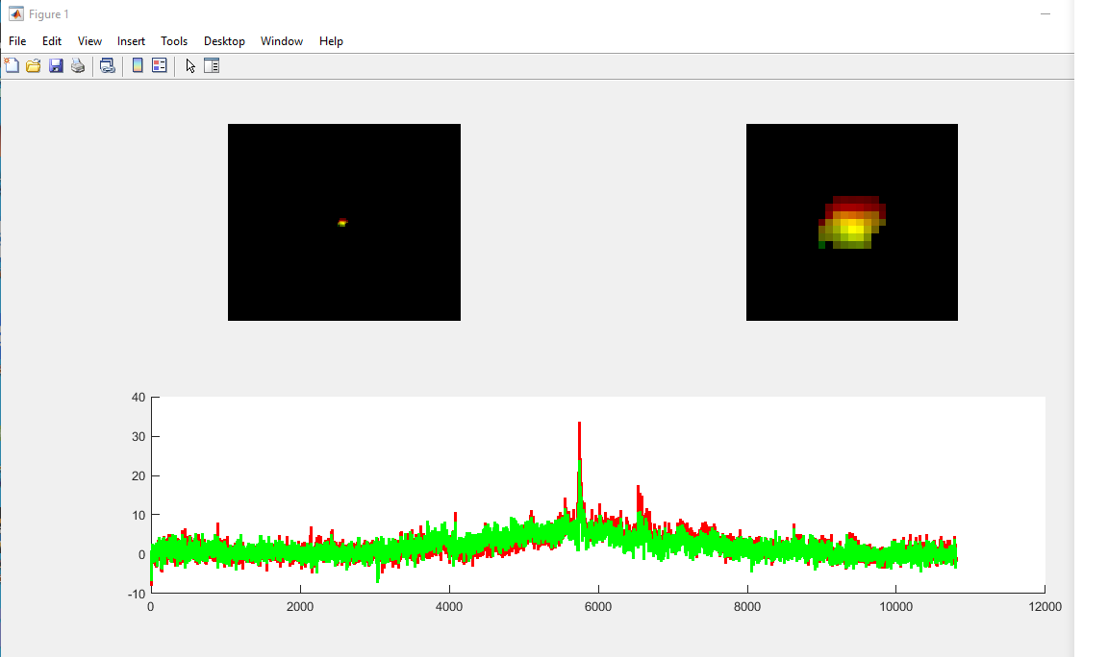
These cells should be merged

Slide 11
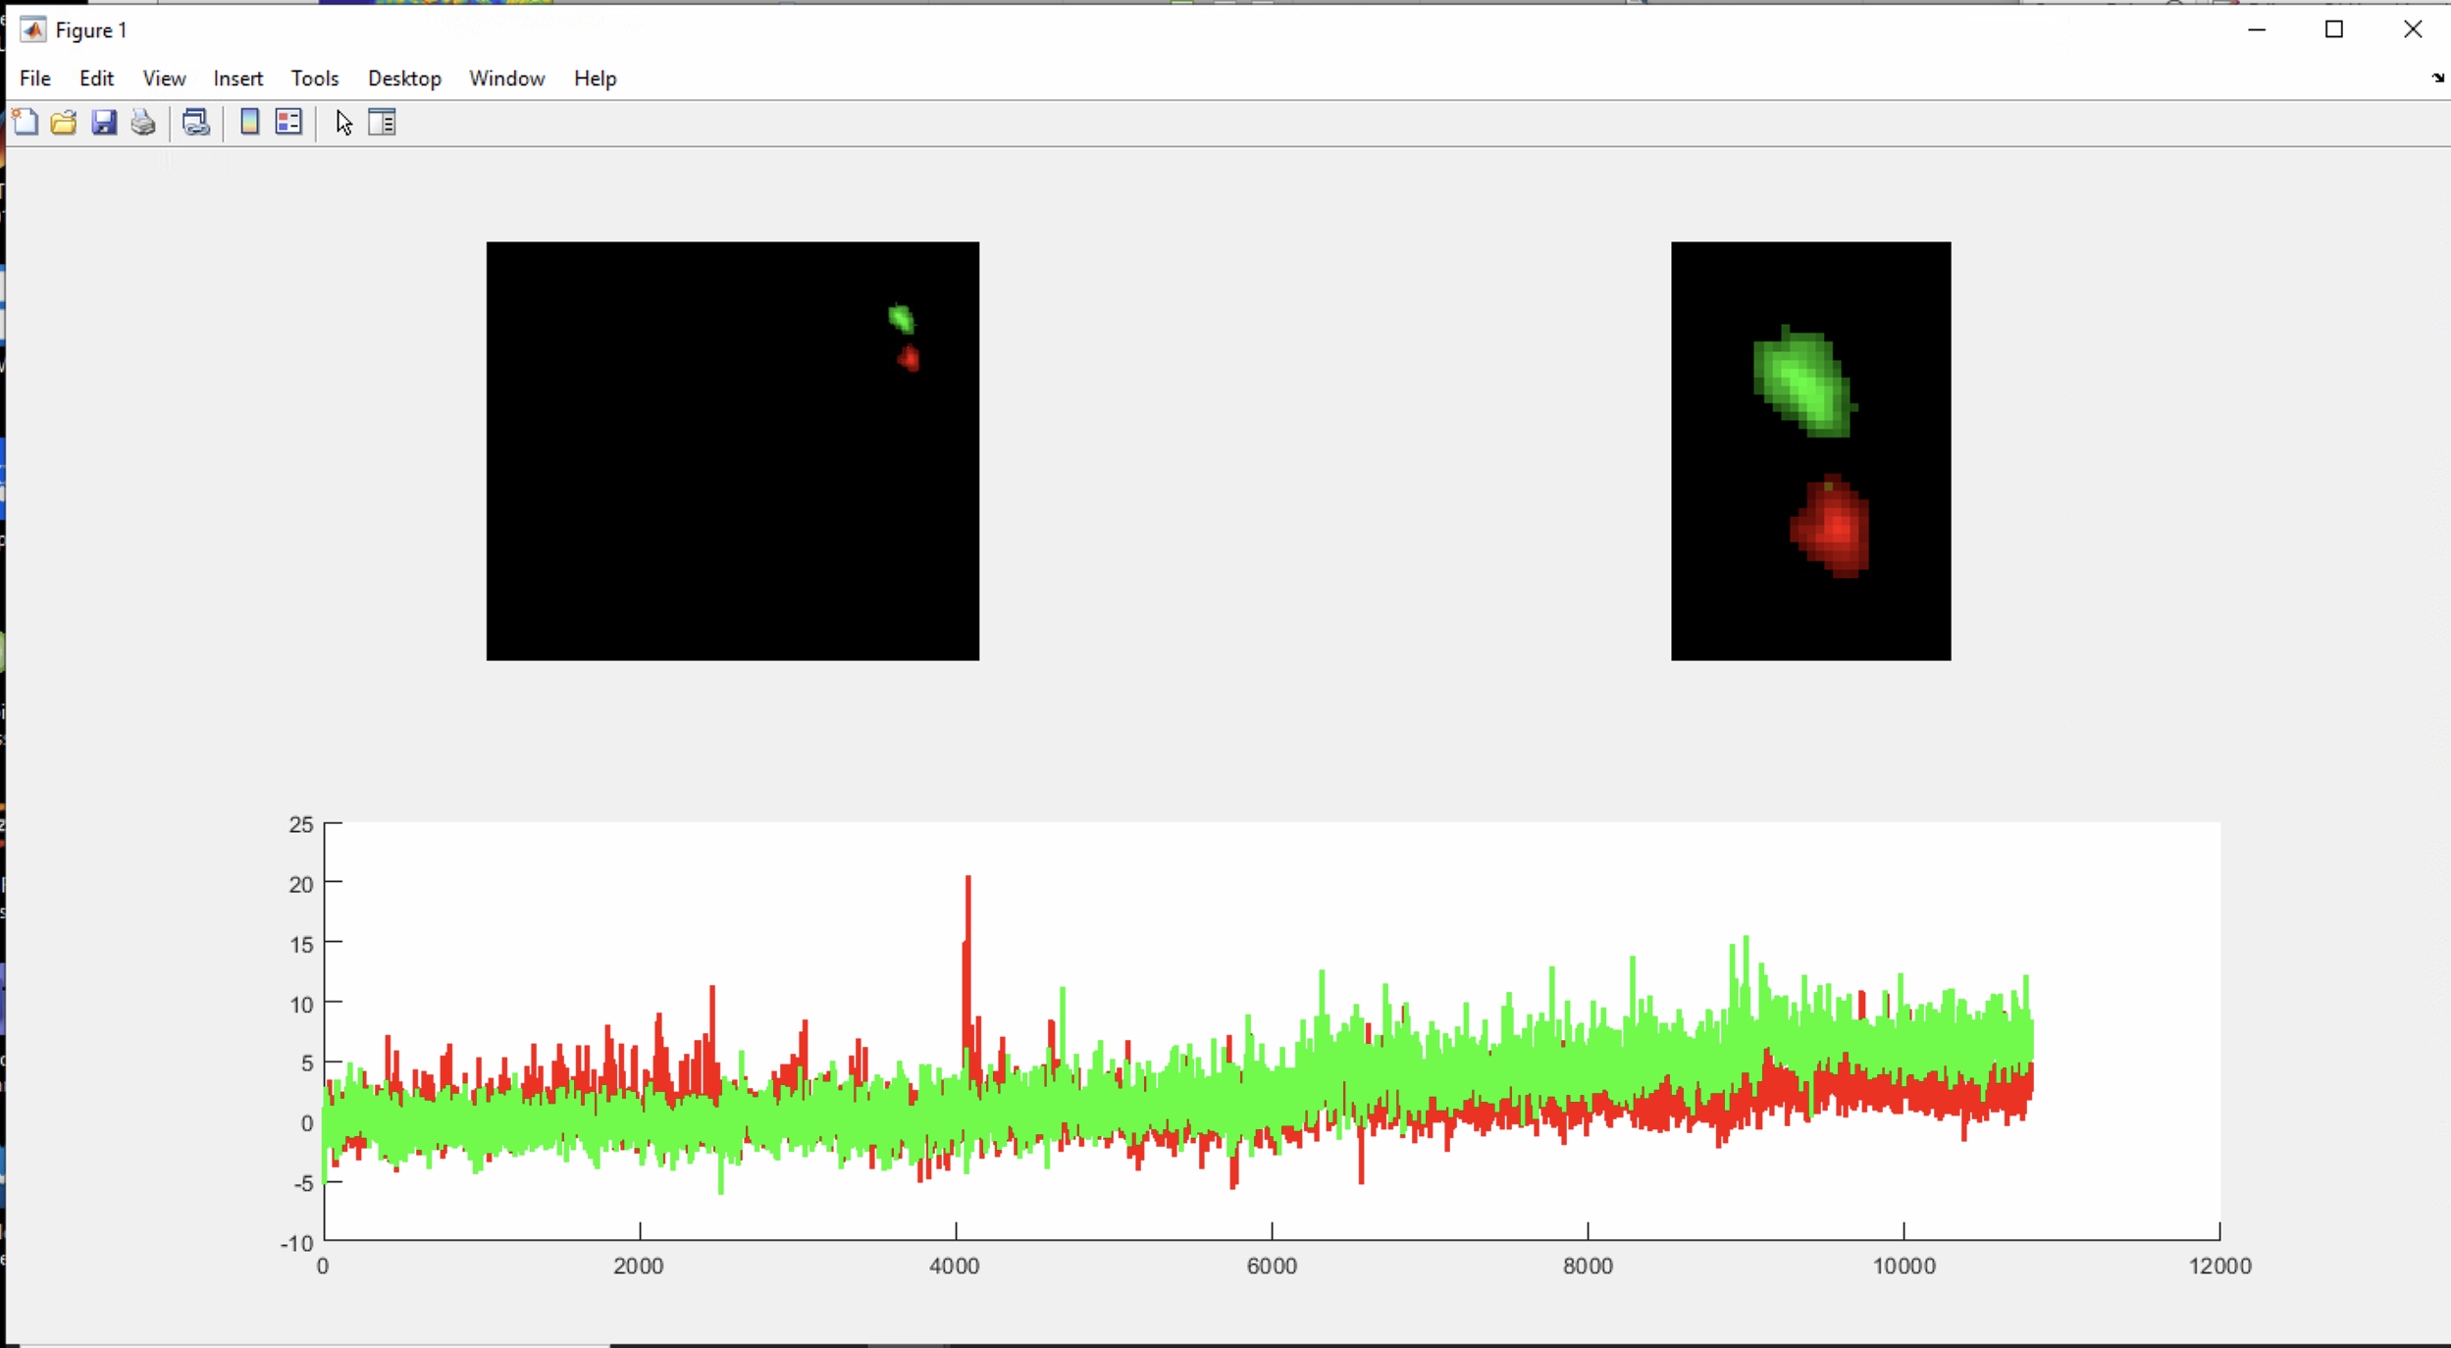
These cells should NOT be merged

Slide 12
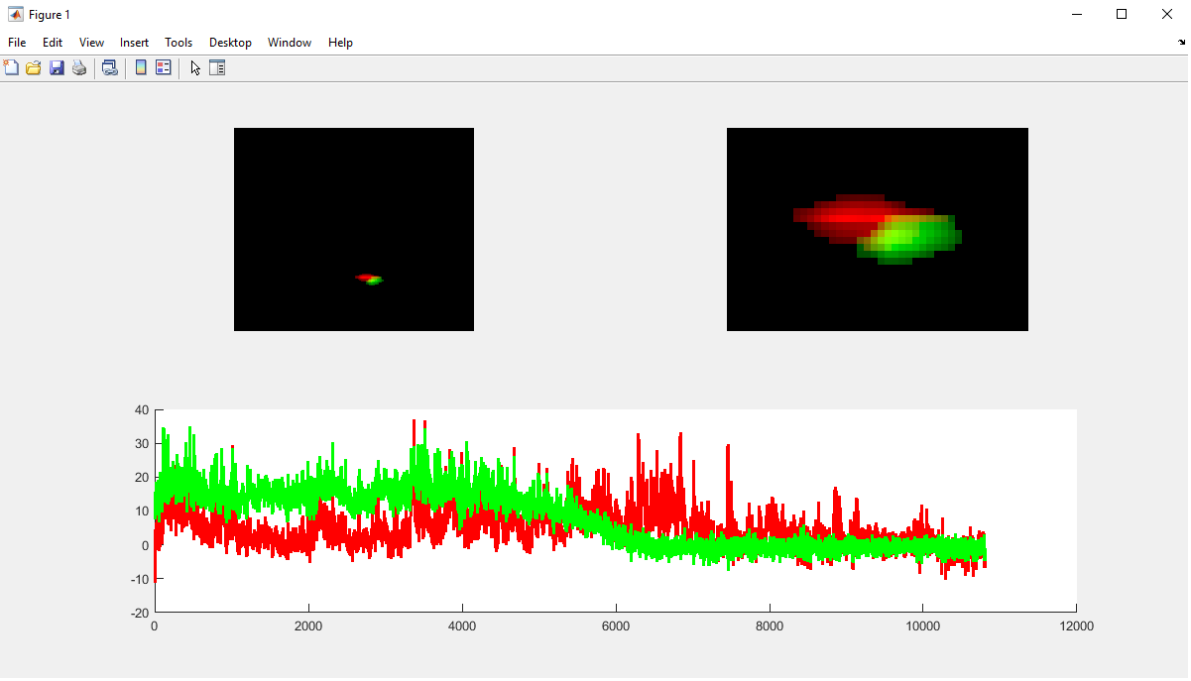
These cells could be merged

Slide 13
Merging cells
This process is inherently subjective.
While the first two examples were obvious, the third is ambiguous.
Some of the activity overlaps (especially in the first half), but some doesn’t.
The cells don’t overlap but they are directly bordering.
For ambiguous cases like this, it can be helpful to look at the video itself side-by-side.
That said, you will sometimes remain uncertain. It’s best to develop personal rules for these cases (e.g. never merge if in doubt) and to be consistent.

Slide 14
Deleting cells
After merging various cells, you will be given every ROI to decide whether or not it is a cell.
Some rules for deleting cells:
If using GCaMP (and most NT sensors), you should see clear, positive-moving spikes. If you do not, delete the cell.
If the activity trace shows substantial and constant/exponential drift down or up, delete the cell (this could be due to bleaching artefacts).
If this happens a lot in your recordings, use a lower LED power or pre-bleach (have the LED turned on before the experiment and at a higher power)
Delete cells that are near the edge of the lens (even if they are real). They will be optically distorted and are more likely to drift in and out of view.

Slide 15
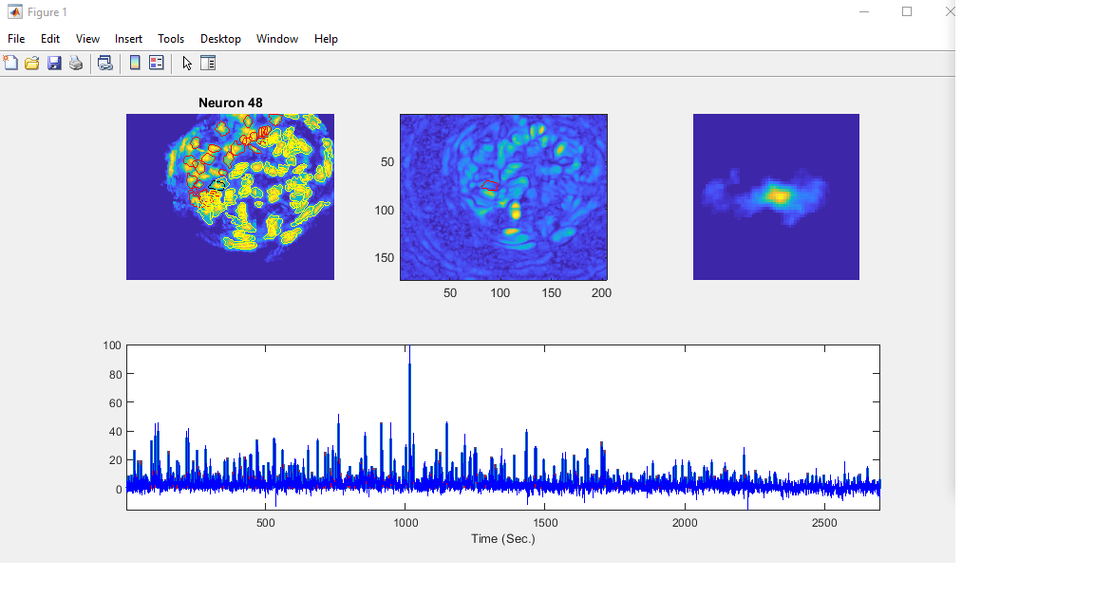
This is a cell (albeit a noisy one)

Slide 16
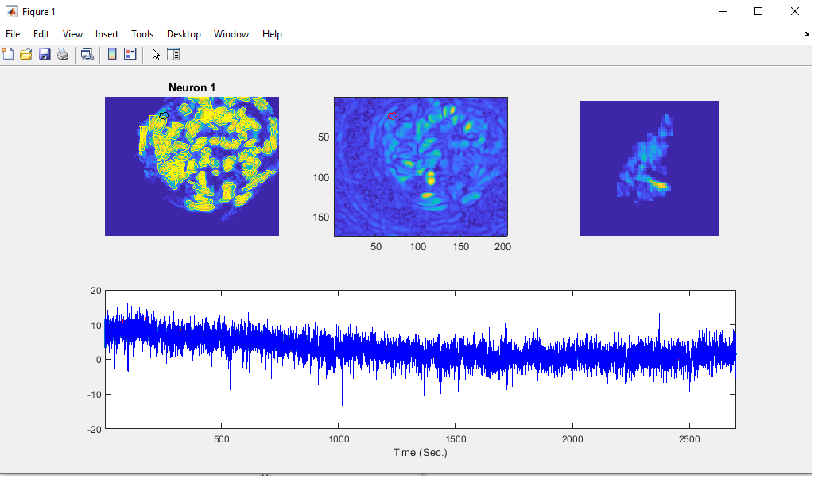
This is NOT a cell

Slide 17
Deleting cells
You will be given a series of cells to decide upon
Press enter (or k and then enter) to keep the cell
Press d and then enter to delete the cell
Press b and then enter to go back to the previous decision
The ROIs change to red (from yellow) if kept, and disappear if deleted
You can also change the ROI slightly
Press t and then enter to trim the cell (then draw around the cell)
Press s and then enter to split the cell (then draw around one of the cells)

Slide 18
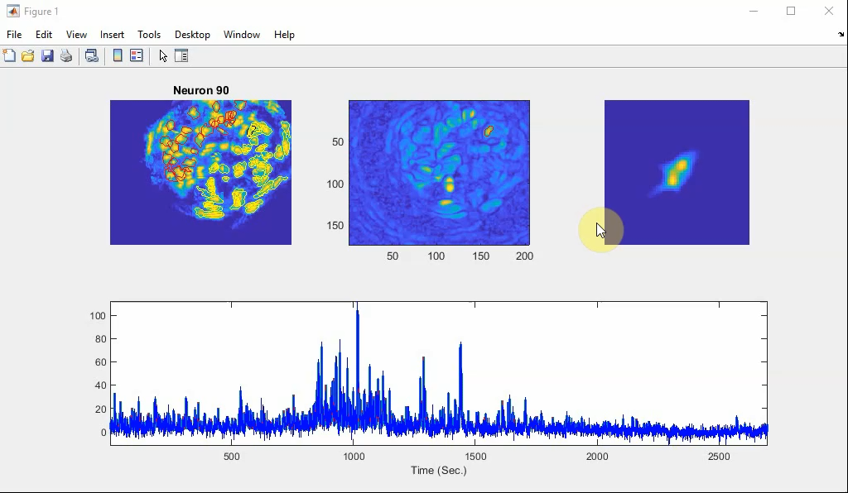
Splitting a cell

Slide 19
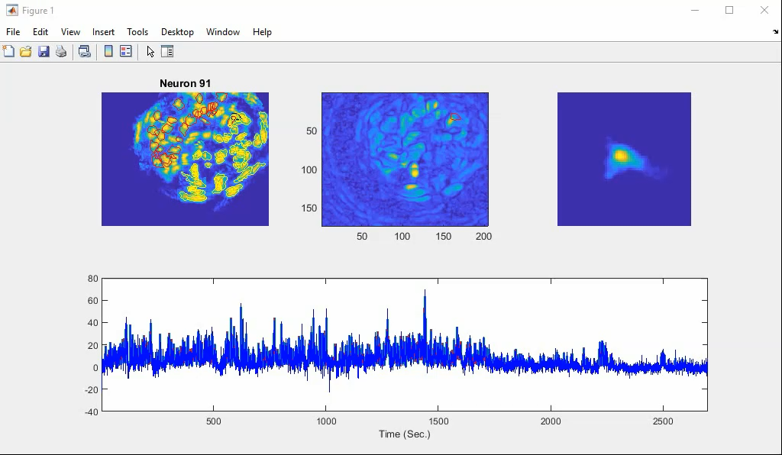
Trimming a cell

Slide 20
Deleting cells
Sometimes you might want to merge part of an ROI with another ROI. To do this, split the ROI and then rerun the script with the newly generated dataset.
You might have noticed that the neurons in those two examples were rather close to one another, and had some shared activity patterns. It’s possible that I might want to merge part of the cell I split with the second cell.
Sometimes you will find cells that should have been merged but for whatever reason weren’t in the previous step. In these cases, you can either delete one copy of the neuron or rerun the script.

Slide 21
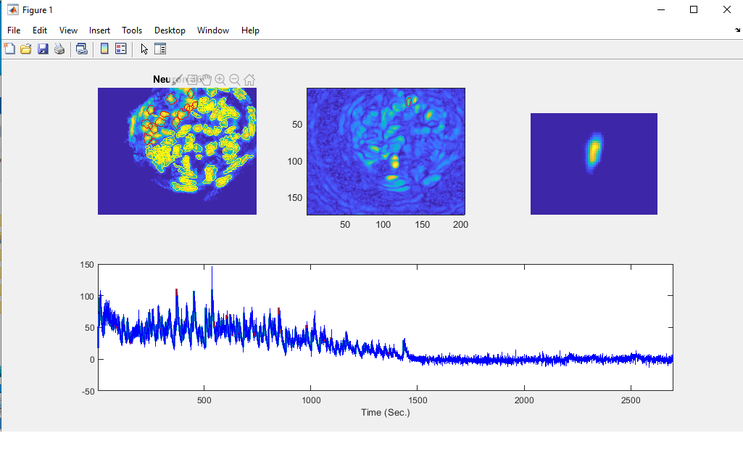
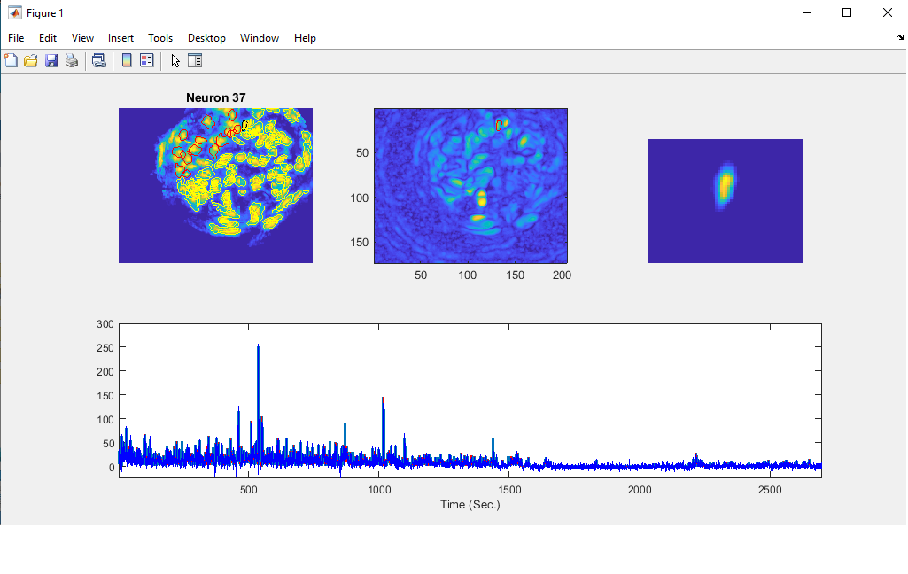
Deleting cells
These are two ROIs that should have been merged. The first activity trace is essentially the second with a longer decay rate. This happens when one ROI captures a soma and another a process.

Slide 22
Deleting cells
Once you are done making your decisions, the script will create a new dataset.
This dataset is named (original video name)-pp-BP-MC_wspace_small.mat
You might want to rerun this new dataset through the script.
As is likely apparent, deciding what cells to delete is highly subjective and very prone to bias. It is imperative to find a way to blind yourself. Don’t do this on videos where you know what experiment is being done.
But if not, you are done and can move onto data analysis!

Slide 23
Data analysis: Lickometer
In addition to the .isxd video file, you should also be able to find two other files in the original folder produced during the recording
There is a file containing TTL input (.gpio)
There is a file containing accelerometer data (.imu)
Open the .gpio file for each video up in the most recent Inscopix IDAS software and export it as a .csv
Write down the relevant metadata information in metadata.csv
Run lick_analysis.m in Matlab
Example datasets for this pipeline have been provided on dropbox

